Slide 1

Multi-Directional Smart Bicycle Blind Spot & Collision Alert System
Presented To:
Md. Julkar Naim Joy
Adjunct Lecturer, Dept. of CSE
Southeast University
Presented By:
Nusrat Jahan Nawal
Md. Fozle Hasan Asif
Nusrat Jahan Rafi
Md. Suvro Biswas

Slide 2
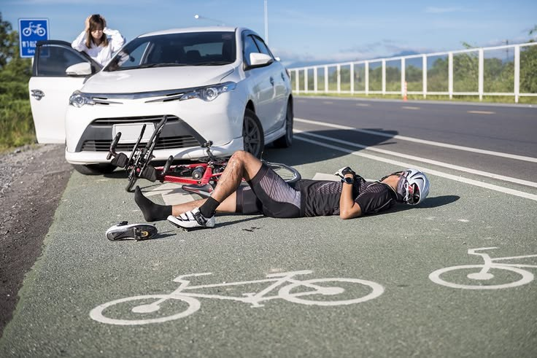
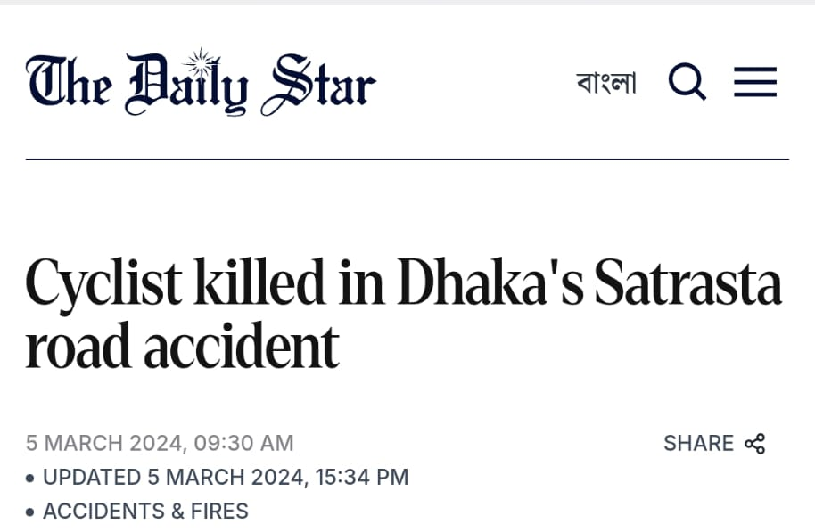

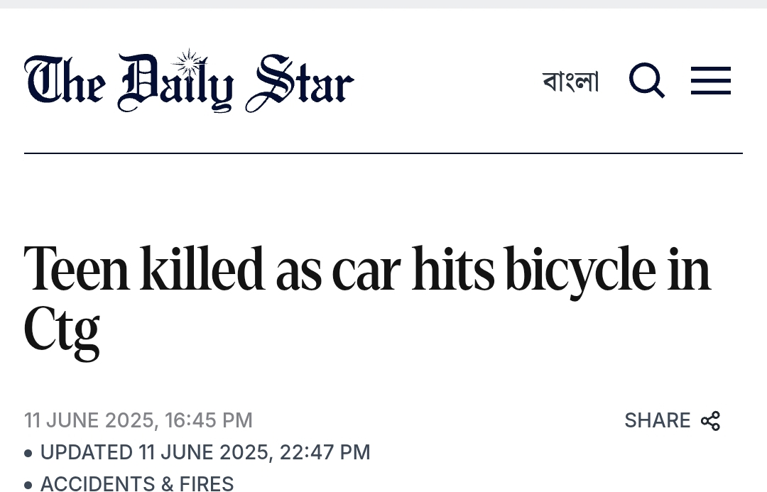
Problem Statement
Cyclists cannot see blind spots easily so high risk of collision from back and sides
No affordable smart safety system for people
Page - 1

Slide 3
Project Idea
“A multi-directional collision alert system designed for bicycle and rickshaw riders that detects vehicles approaching from the left, right, and rear sides and provides real-time warnings using LCD, buzzer, and a critical LED alert ”
Who will Benefit:
Student cyclists
Delivery riders such as FoodPanda, Pathao riders
Rickshaw pullers
Page - 2

Slide 4

Project Overview
3 Ultrasonic Sensors (Left, Right, Back)
Arduino processes data
Measures distance and show collision risk in real-time through speed analysis
Displays warnings on an LCD screen
Alerts are generated when actual danger is detected .Uses a buzzer for alerts
Activates a red LED only in critical situations
Page - 3

Slide 5
Key Features
Multi-Directional Detection System:
i. 3 ultrasonic sensors (Left, Right, Back)
ii. Covers all blind spots and provides full directional awareness
2. Real-Time Distance Analysis :
i. Measures distance in centimeters
ii. Detects closest vehicle and prioritizes highest risk direction
3. Speed Approximation:
i. Calculates speed using distance change
ii. Fast decrease → High risk and Slow decrease → Normal condition
4. Smart LCD Display (MAIN OUTPUT) :
i. Displays all system information
ii. Shows direction and distance clearly and provides real-time safety
messages
Page - 4

Slide 6
Key Features
5. Buzzer Alert System:
Condition | Buzzer
Safe | OFF
Warning | Slow beep
High risk | Fast beep
Critical | Continuous loud sound
6. Critical Safety LED:
i. Activates only in critical condition which
indicates emergency situation
ii. Red LED ON + continuous buzzer
7. False Alert Reduction System
i. Uses multiple sensor readings and averages data for accuracy
iii. Ignores sudden spikes
Page - 5

Slide 7
Output States (LCD Display)
1. SAFE STATE:
All Clear.
L: Safe | R: Safe | B: Safe
2. WARNING :
Vehicle approaching
Shows direction + distance
3. HIGH RISK :
Danger Zone ! Vehicle very close !
Shows direction + distance
4. CRITICAL :
STOP IMMEDIATELY !!!
Collision Risk Detected
Shows direction + distance
Page - 7

Slide 8
Components
1. Arduino Uno / Nano
2. HC-SR04 Ultrasonic Sensors ×3
3. LCD 16×2 Display
4. Buzzer Red LED
5. Battery / Power Bank
6. Toy Bicycle Model
Estimated Cost
Total Cost: Tk1500 – Tk 2000 (approx.)
Low-cost and affordable solution &Suitable for mass use
Page - 8

Slide 9
Physical Design
[Left Sensor] [Right Sensor]
\ /
\ /
─── Bicycle ───
│
[Back Sensor]
│
[Arduino Box Below]
│
[LCD Display on Handle]
[Red LED + Buzzer Unit]
Page – 9

Slide 10
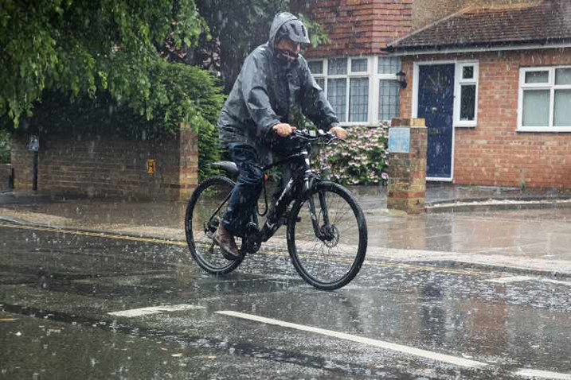
Potential Risks / Challenges
Ultrasonic sensors may be affected by rain, dust, or uneven road surfaces
False alerts may occur in crowded traffic environments
Detection accuracy can reduce at high vehicle speeds
Battery life and power management need optimization
Page - 10

Slide 11
Future Advancement
Integrating AI for smarter object and risk prediction
Adding GPS and mobile app connectivity for tracking & alerts
Using camera/radar sensors for higher accuracy
Developing waterproof and compact real-world design
Expanding system for motorcycles and other vehicles
Page - 11

Slide 12

Conclusion
Multi-directional real-time collision alert system
Simple, low-cost, and effective for road safety
Reduces blind spot risks and improves rider awareness
Suitable for future real-world development
Page - 12

